Slide 1
Better Derivative Control
By Howard Beck

Slide 2
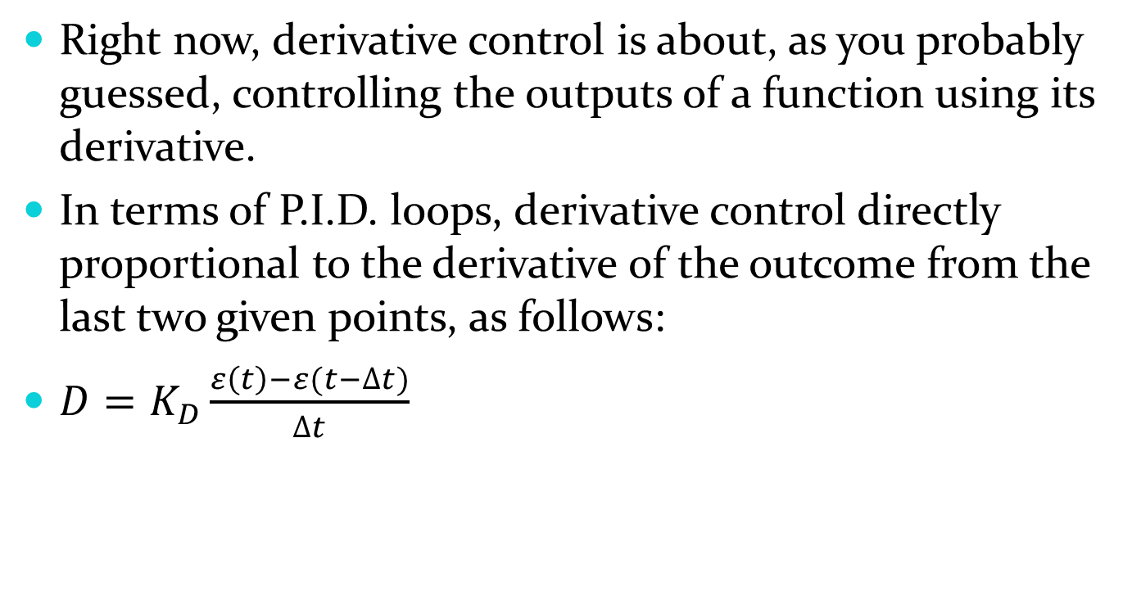
Derivative Control – Right Now
Right now, derivative control is about, as you probably guessed, controlling the outputs of a function using its derivative.
In terms of P.I.D. loops, derivative control directly proportional to the derivative of the outcome from the last two given points, as follows:
$D=K_{D}\frac{ε\left(t\right)−ε(t−∆t)}{∆t}$

Slide 3
Derivative Control Problem
Derivative control can be great when it comes to instances where the change in time is constant: the derivative control just becomes proportional to the change in error.
The problem with this is that if the change in error is less predictable, the derivative control gives weird results.

Slide 4
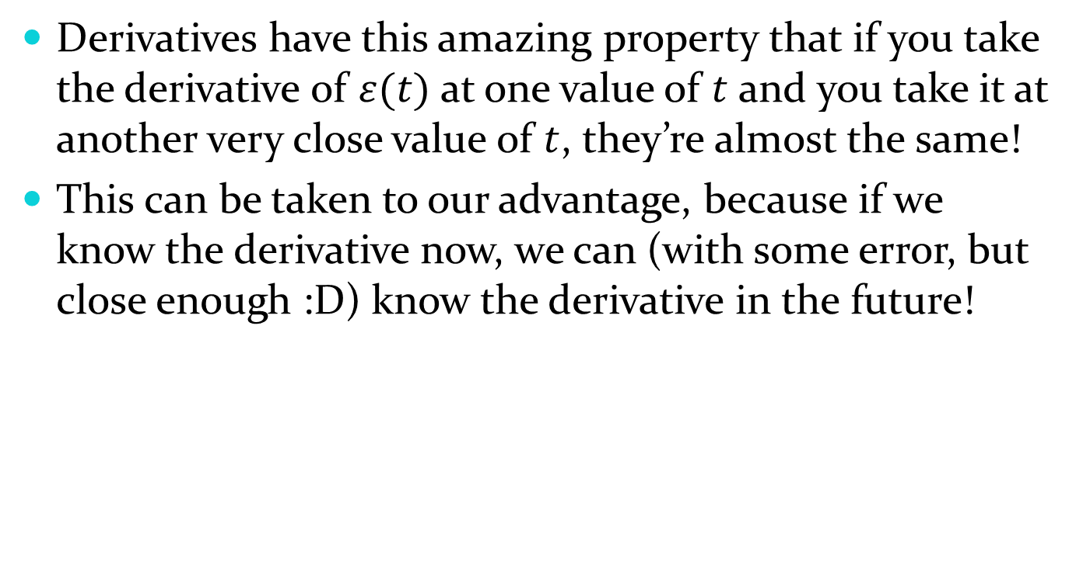
Better Derivative Control
Derivatives have this amazing property that if you take the derivative of $ε(t)$ at one value of $t$ and you take it at another very close value of $t$, they’re almost the same!
This can be taken to our advantage, because if we know the derivative now, we can (with some error, but close enough :D) know the derivative in the future!

Slide 5
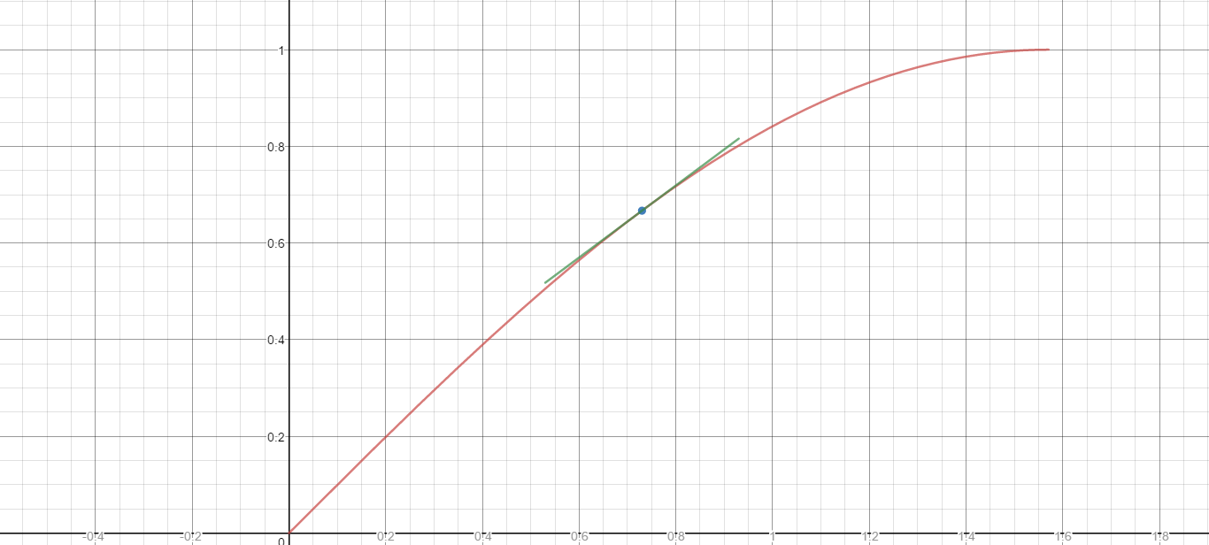
Derivatives Are Similar

Slide 6
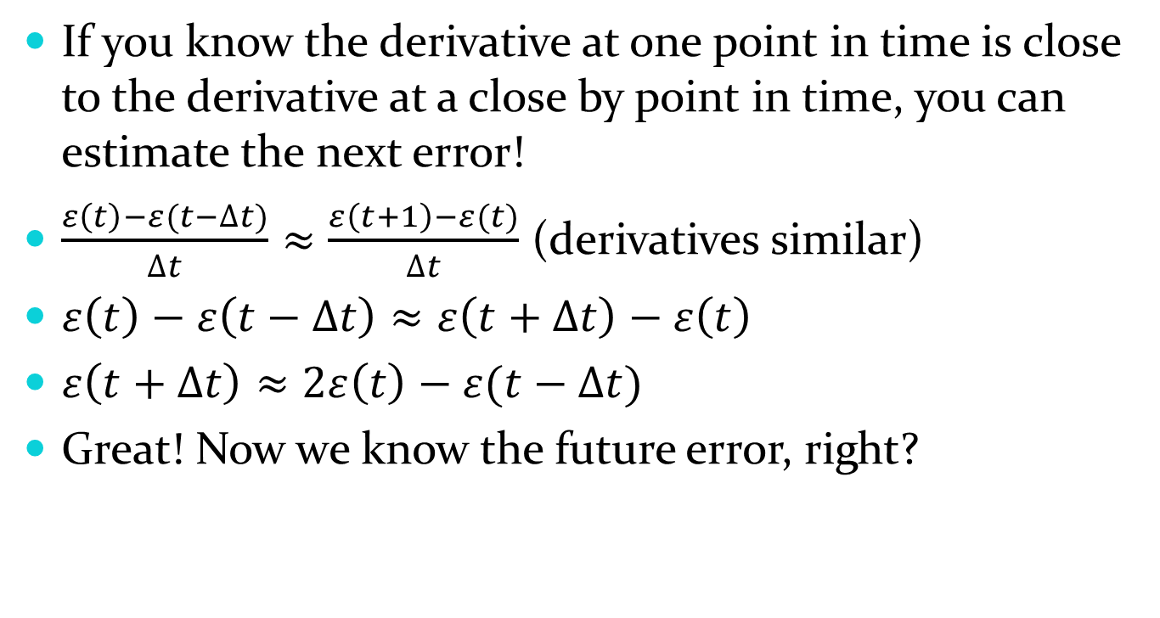
Predicting the Future – Math Style
If you know the derivative at one point in time is close to the derivative at a close by point in time, you can estimate the next error!
$\frac{ε\left(t\right)−ε(t−∆t)}{∆t}≈\frac{ε\left(t+1\right)−ε(t)}{∆t}$ (derivatives similar)
$ε\left(t\right)−ε\left(t−∆t\right)≈ε\left(t+∆t\right)−ε\left(t\right)$
$ε\left(t+∆t\right)≈2ε\left(t\right)−ε(t−∆t)$
Great! Now we know the future error, right?

Slide 7
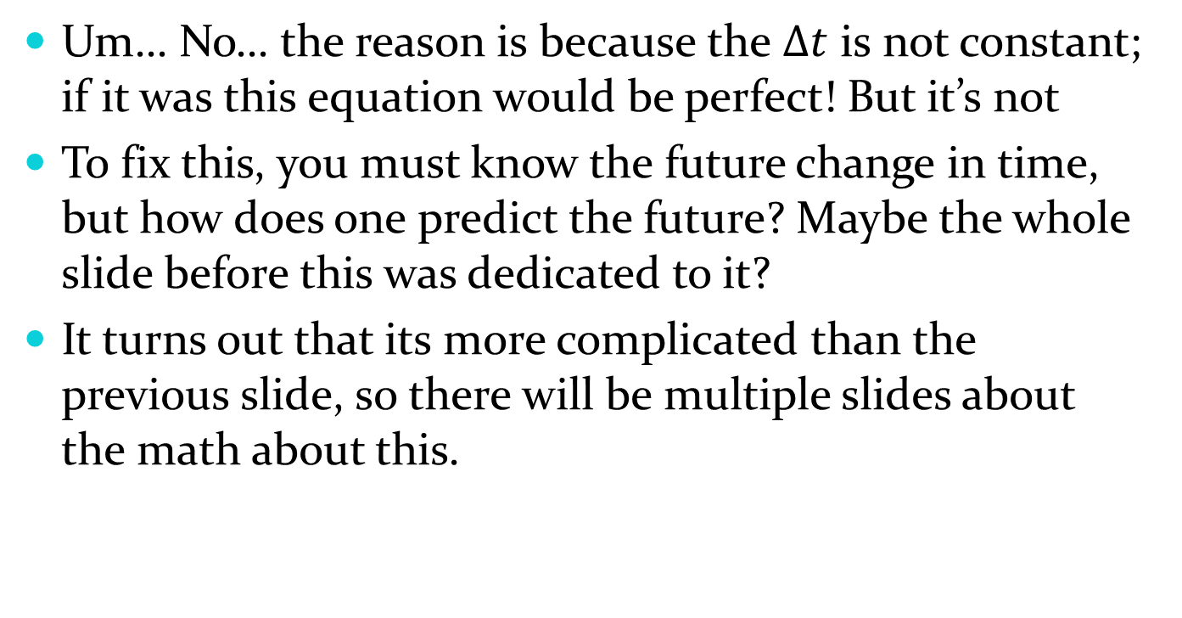
Adjusting the Prediction…
Um… No… the reason is because the $∆t$ is not constant; if it was this equation would be perfect! But it’s not
To fix this, you must know the future change in time, but how does one predict the future? Maybe the whole slide before this was dedicated to it?
It turns out that its more complicated than the previous slide, so there will be multiple slides about the math about this.

Slide 8
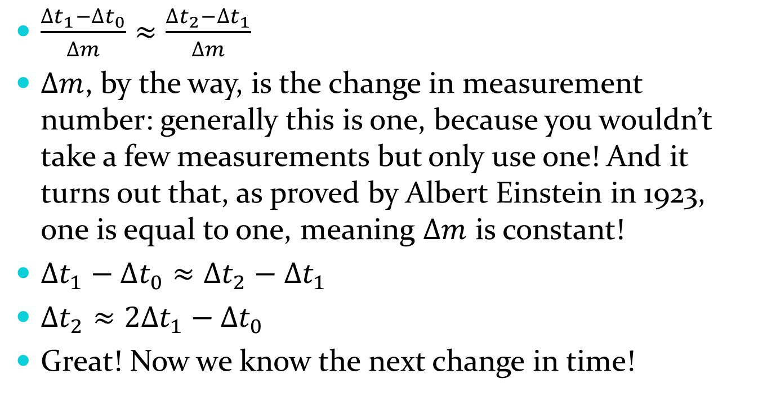

Predicting $∆t$
$\frac{∆t_{1}−∆t_{0}}{∆m}≈\frac{∆t_{2}−∆t_{1}}{∆m}$
$∆m$, by the way, is the change in measurement number: generally this is one, because you wouldn’t take a few measurements but only use one! And it turns out that, as proved by Albert Einstein in 1923, one is equal to one, meaning $∆m$ is constant!
$∆t_{1}−∆t_{0}≈∆t_{2}−∆t_{1}$
$∆t_{2}≈2∆t_{1}−∆t_{0}$
Great! Now we know the next change in time!

Slide 9
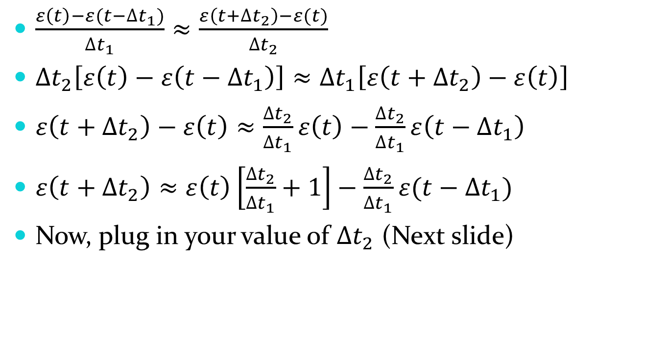
Predicting Next Error
$\frac{ε\left(t\right)−ε(t−∆t_{1})}{∆t_{1}}≈\frac{ε\left(t+∆t_{2}\right)−ε(t)}{∆t_{2}}$
$∆t_{2}\left[ε\left(t\right)−ε\left(t−∆t_{1}\right)\right]≈∆t_{1}\left[ε\left(t+∆t_{2}\right)−ε\left(t\right)\right]$
$ε\left(t+∆t_{2}\right)−ε\left(t\right)≈\frac{∆t_{2}}{∆t_{1}}ε\left(t\right)−\frac{∆t_{2}}{∆t_{1}}ε\left(t−∆t_{1}\right)$
$ε\left(t+∆t_{2}\right)≈ε\left(t\right)\left[\frac{∆t_{2}}{∆t_{1}}+1\right]−\frac{∆t_{2}}{∆t_{1}}ε(t−∆t_{1})$
Now, plug in your value of $∆t_{2}$ (Next slide)

Slide 10
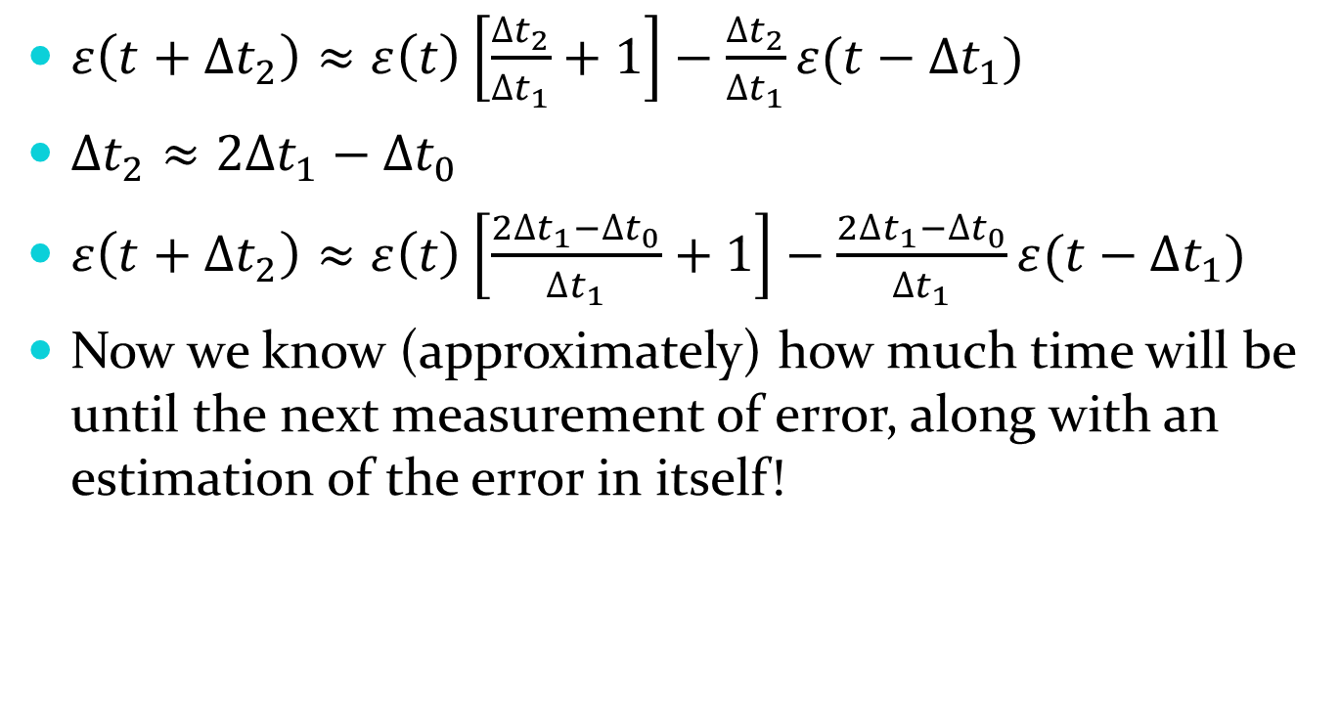
Predicting Next Error
$ε\left(t+∆t_{2}\right)≈ε\left(t\right)\left[\frac{∆t_{2}}{∆t_{1}}+1\right]−\frac{∆t_{2}}{∆t_{1}}ε(t−∆t_{1})$
$∆t_{2}≈2∆t_{1}−∆t_{0}$
$ε\left(t+∆t_{2}\right)≈ε\left(t\right)\left[\frac{2∆t_{1}−∆t_{0}}{∆t_{1}}+1\right]−\frac{2∆t_{1}−∆t_{0}}{∆t_{1}}ε(t−∆t_{1})$
Now we know (approximately) how much time will be until the next measurement of error, along with an estimation of the error in itself!

Slide 11
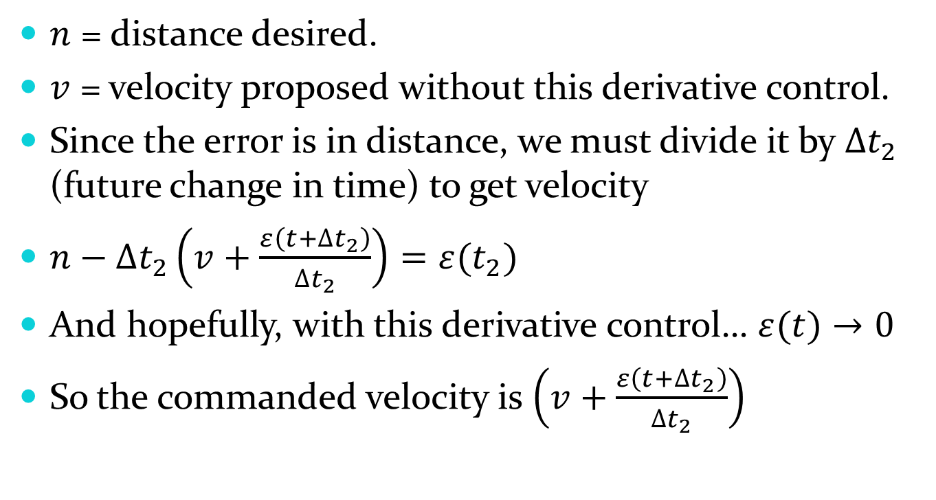
Adjusting For Error
$n$ = distance desired.
$v$ = velocity proposed without this derivative control.
Since the error is in distance, we must divide it by $∆t_{2}$ (future change in time) to get velocity
$n−∆t_{2}\left(v+\frac{ε\left(t+∆t_{2}\right)}{∆t_{2}}\right)=ε(t_{2})$
And hopefully, with this derivative control… $ε(t)→0$
So the commanded velocity is $\left(v+\frac{ε\left(t+∆t_{2}\right)}{∆t_{2}}\right)$

Slide 12
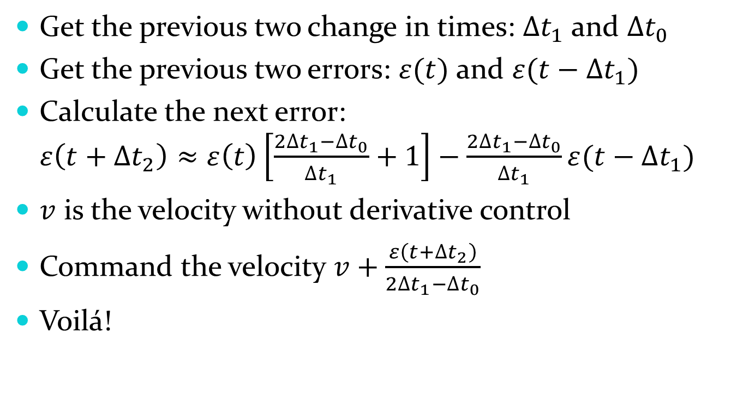
In Conclusion
Get the previous two change in times: $∆t_{1}$ and $∆t_{0}$
Get the previous two errors: $ε(t)$ and $ε(t−∆t_{1})$
Calculate the next error: $ε\left(t+∆t_{2}\right)≈ε\left(t\right)\left[\frac{2∆t_{1}−∆t_{0}}{∆t_{1}}+1\right]−\frac{2∆t_{1}−∆t_{0}}{∆t_{1}}ε(t−∆t_{1})$
$v$ is the velocity without derivative control
Command the velocity $v+\frac{ε\left(t+∆t_{2}\right)}{2∆t_{1}−∆t_{0}}$
Voilá!

Slide 13


Comparison (along with Proportional Control)
Using this Derivative control Using usual Derivative control
T = 13ms, Semi-consistent T = 70ms, Not consistent

